Slide 1
SOFTWARE PROJECT LAB-I
Team-15
Web Based Shooting Game

Slide 2

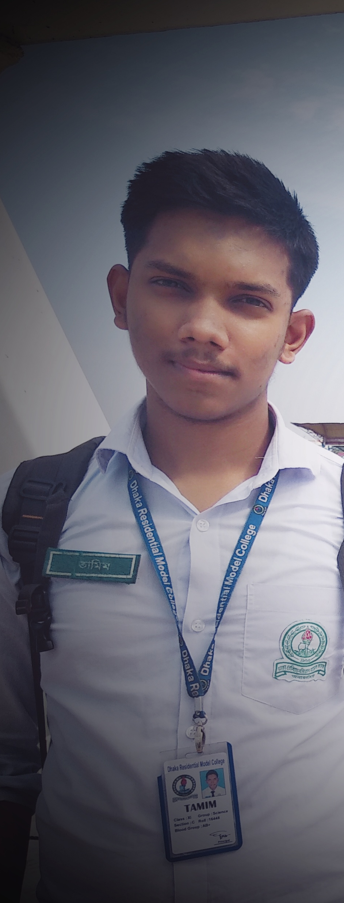

OUR TEAM
Md. Monowarul Amin
Md.Siamul Mubin Tamim
Sami-Ul Haque Showviq
ID: 200042112
ID: 200042130
ID: 200042156
1

Slide 3

ABOUT THE PROJECT
Game
3

Slide 4
OUR TIMELINE
WEEK 4 -5
WEEK 9-11
Finalizing The Proposal
Develpoing the fundamental coding
Planning
Proposal
FINAL
VERSION
WEEK 6-8
WEEK 12-14
Developing the base template
Working with database and front-end
2

Slide 5
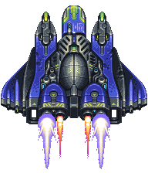
Feature-1:Spaceship
It can move only horizontally
It can shoot bullets in the upper direction
Credit: https://www.pinterest.com/
4

Slide 6
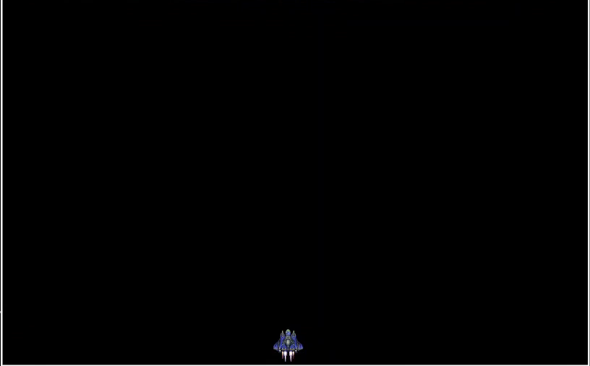
Feature-1:Spaceship(Continue)
Press “Right Arrow” ( ) to move the spaceship “Right”
Press “Left Arrow” ( ) to move the spaceship “Left”
5

Slide 7
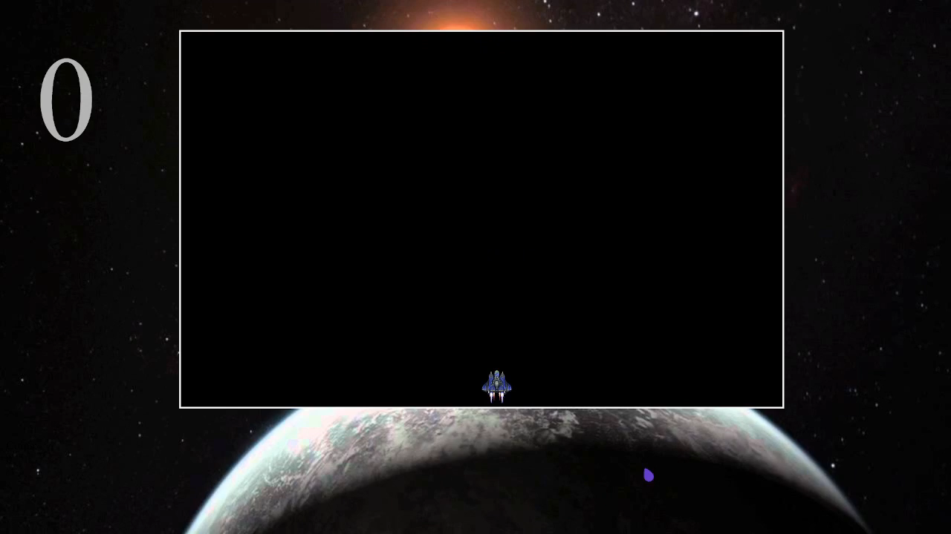
Feature-2:Shooting Bullets
Press “Upper Arrow” ( ) to shoot “Bullets”
Auto sound effect is used here.
6

Slide 8

Feature-3:Stars
There are stars from various galaxies
The player can shoot those stars
Credit: https://en.picmix.com/
7

Slide 9
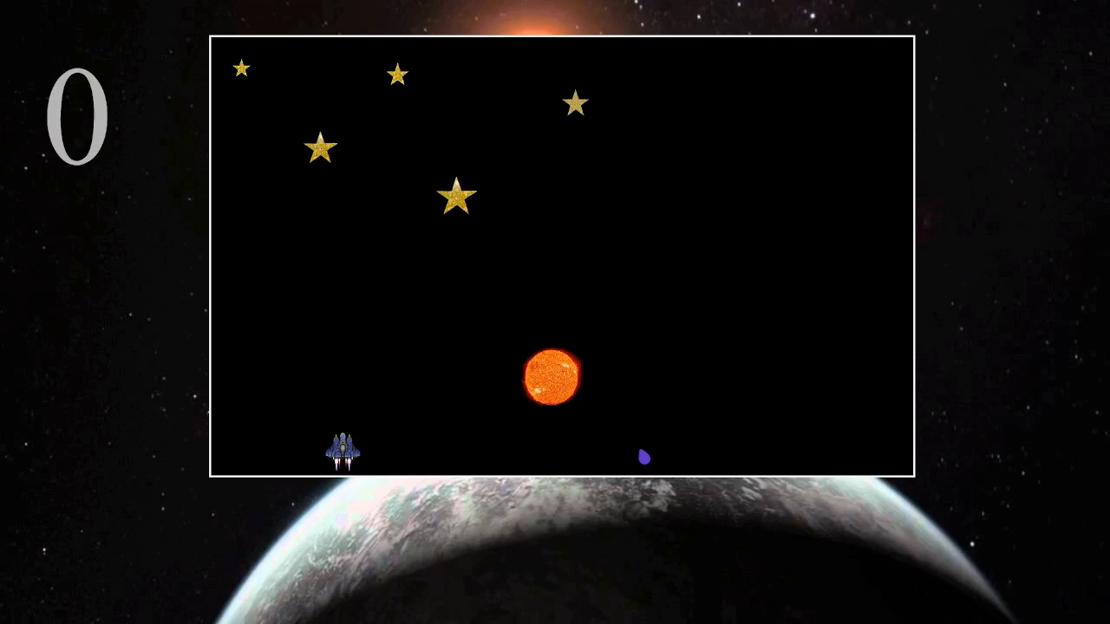
Feature-3:Stars(Continue)
When a bullet hits the star then it will vanish
8

Slide 10

Feature-4:Scoring Points
Removing the star will increase the point of a player
9

Slide 11
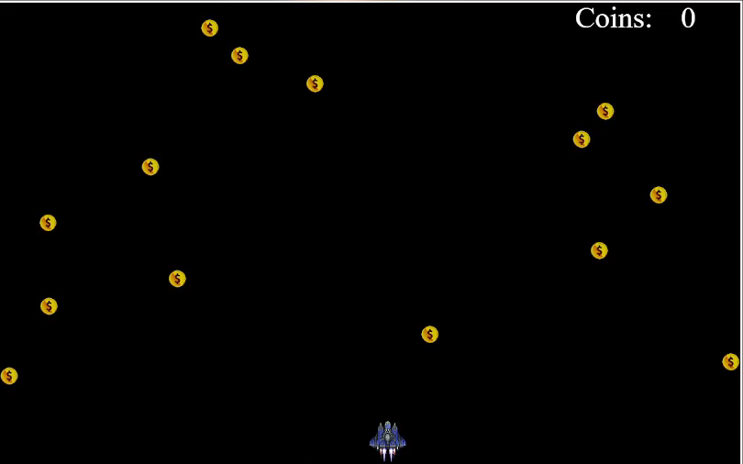
Feature-5:Collecting Coins
Coins will drop randomly from the upper direction
Collected coins will add to the “coin counter”
10

Slide 12
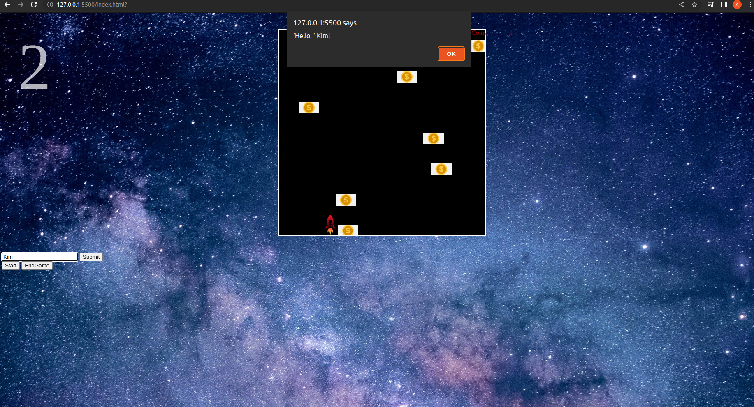
Features Under Testing
Submit “Player Name”
11

Slide 13
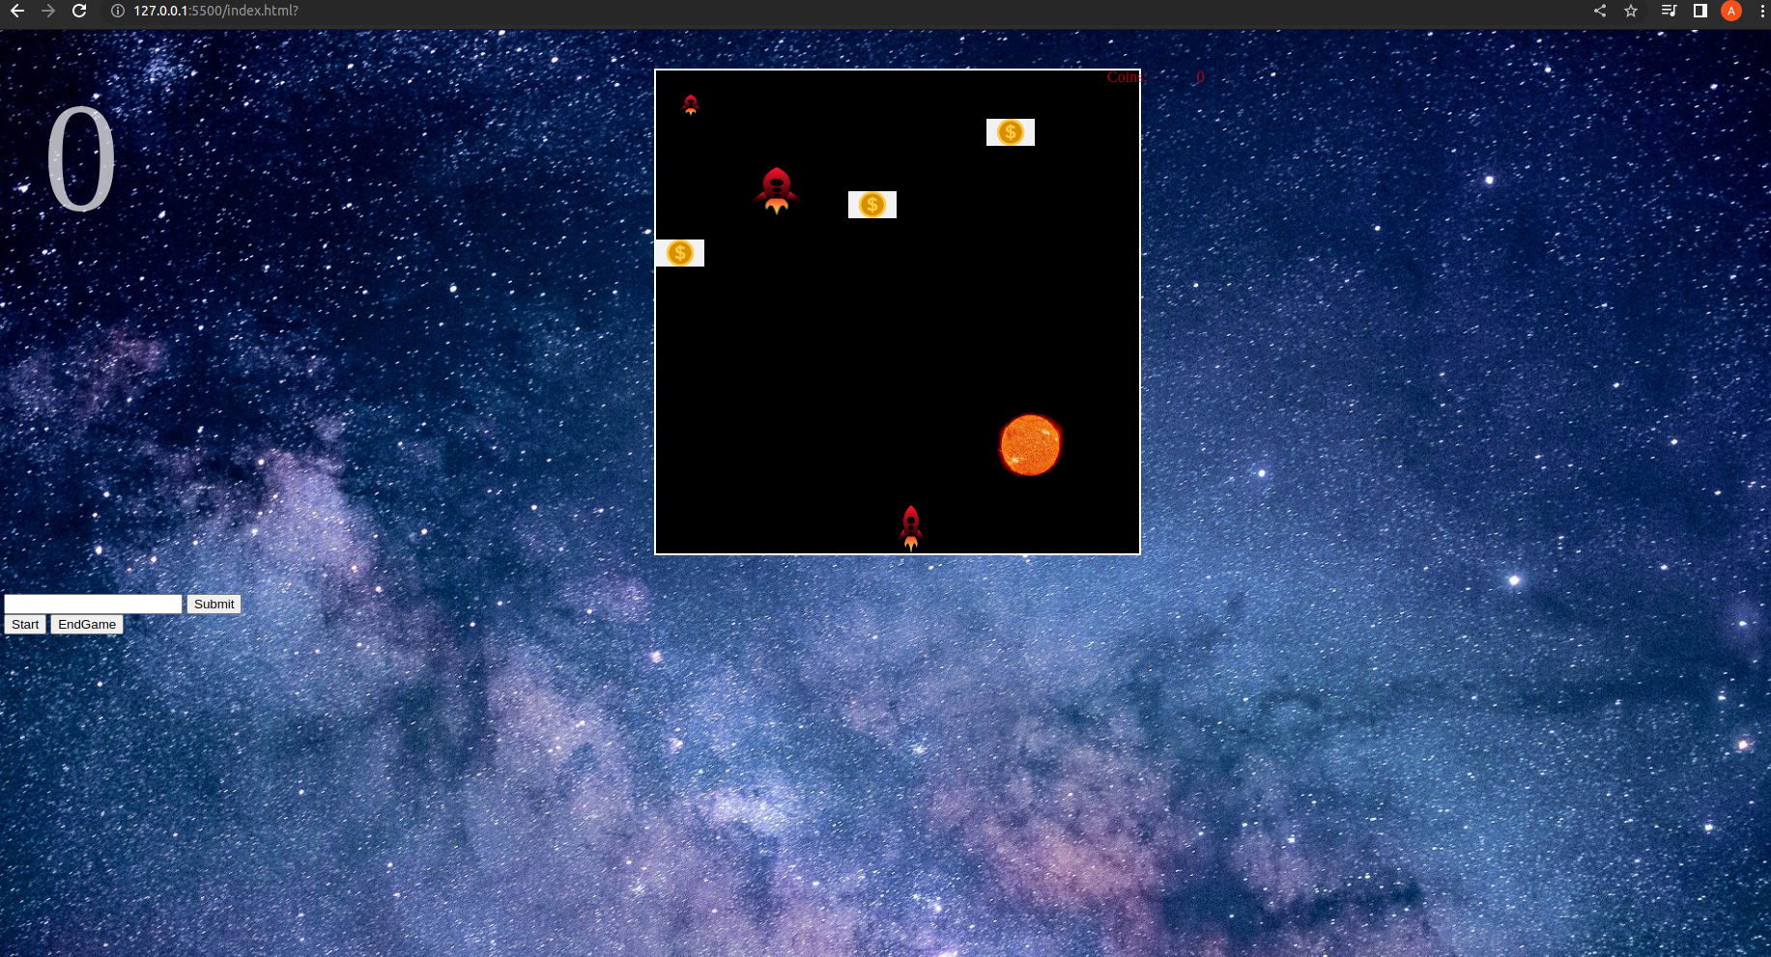
Features Under Testing
Start game function
12

Slide 14
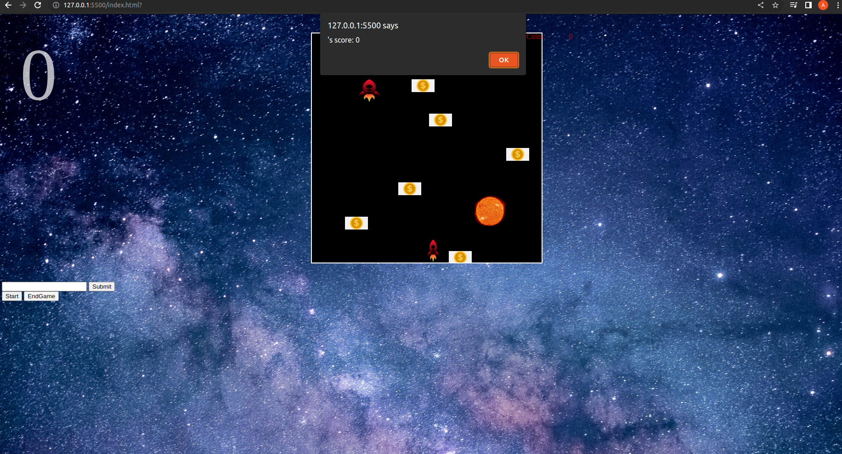
Features Under Testing
End game function
13

Slide 15
Other Features and Future work
There will be a user interface where he/she can see his/her records
Database Management
Top three scorers will be shown in the interface
Implementing the concept of “Theory of Relativity”
14

Slide 16
Problem We Faced
Keep the stars moving
Animation
Implementing database
15

Slide 17
THANKS!

